Slide 1

Shared Convictions of Global Anabaptists

Slide 2
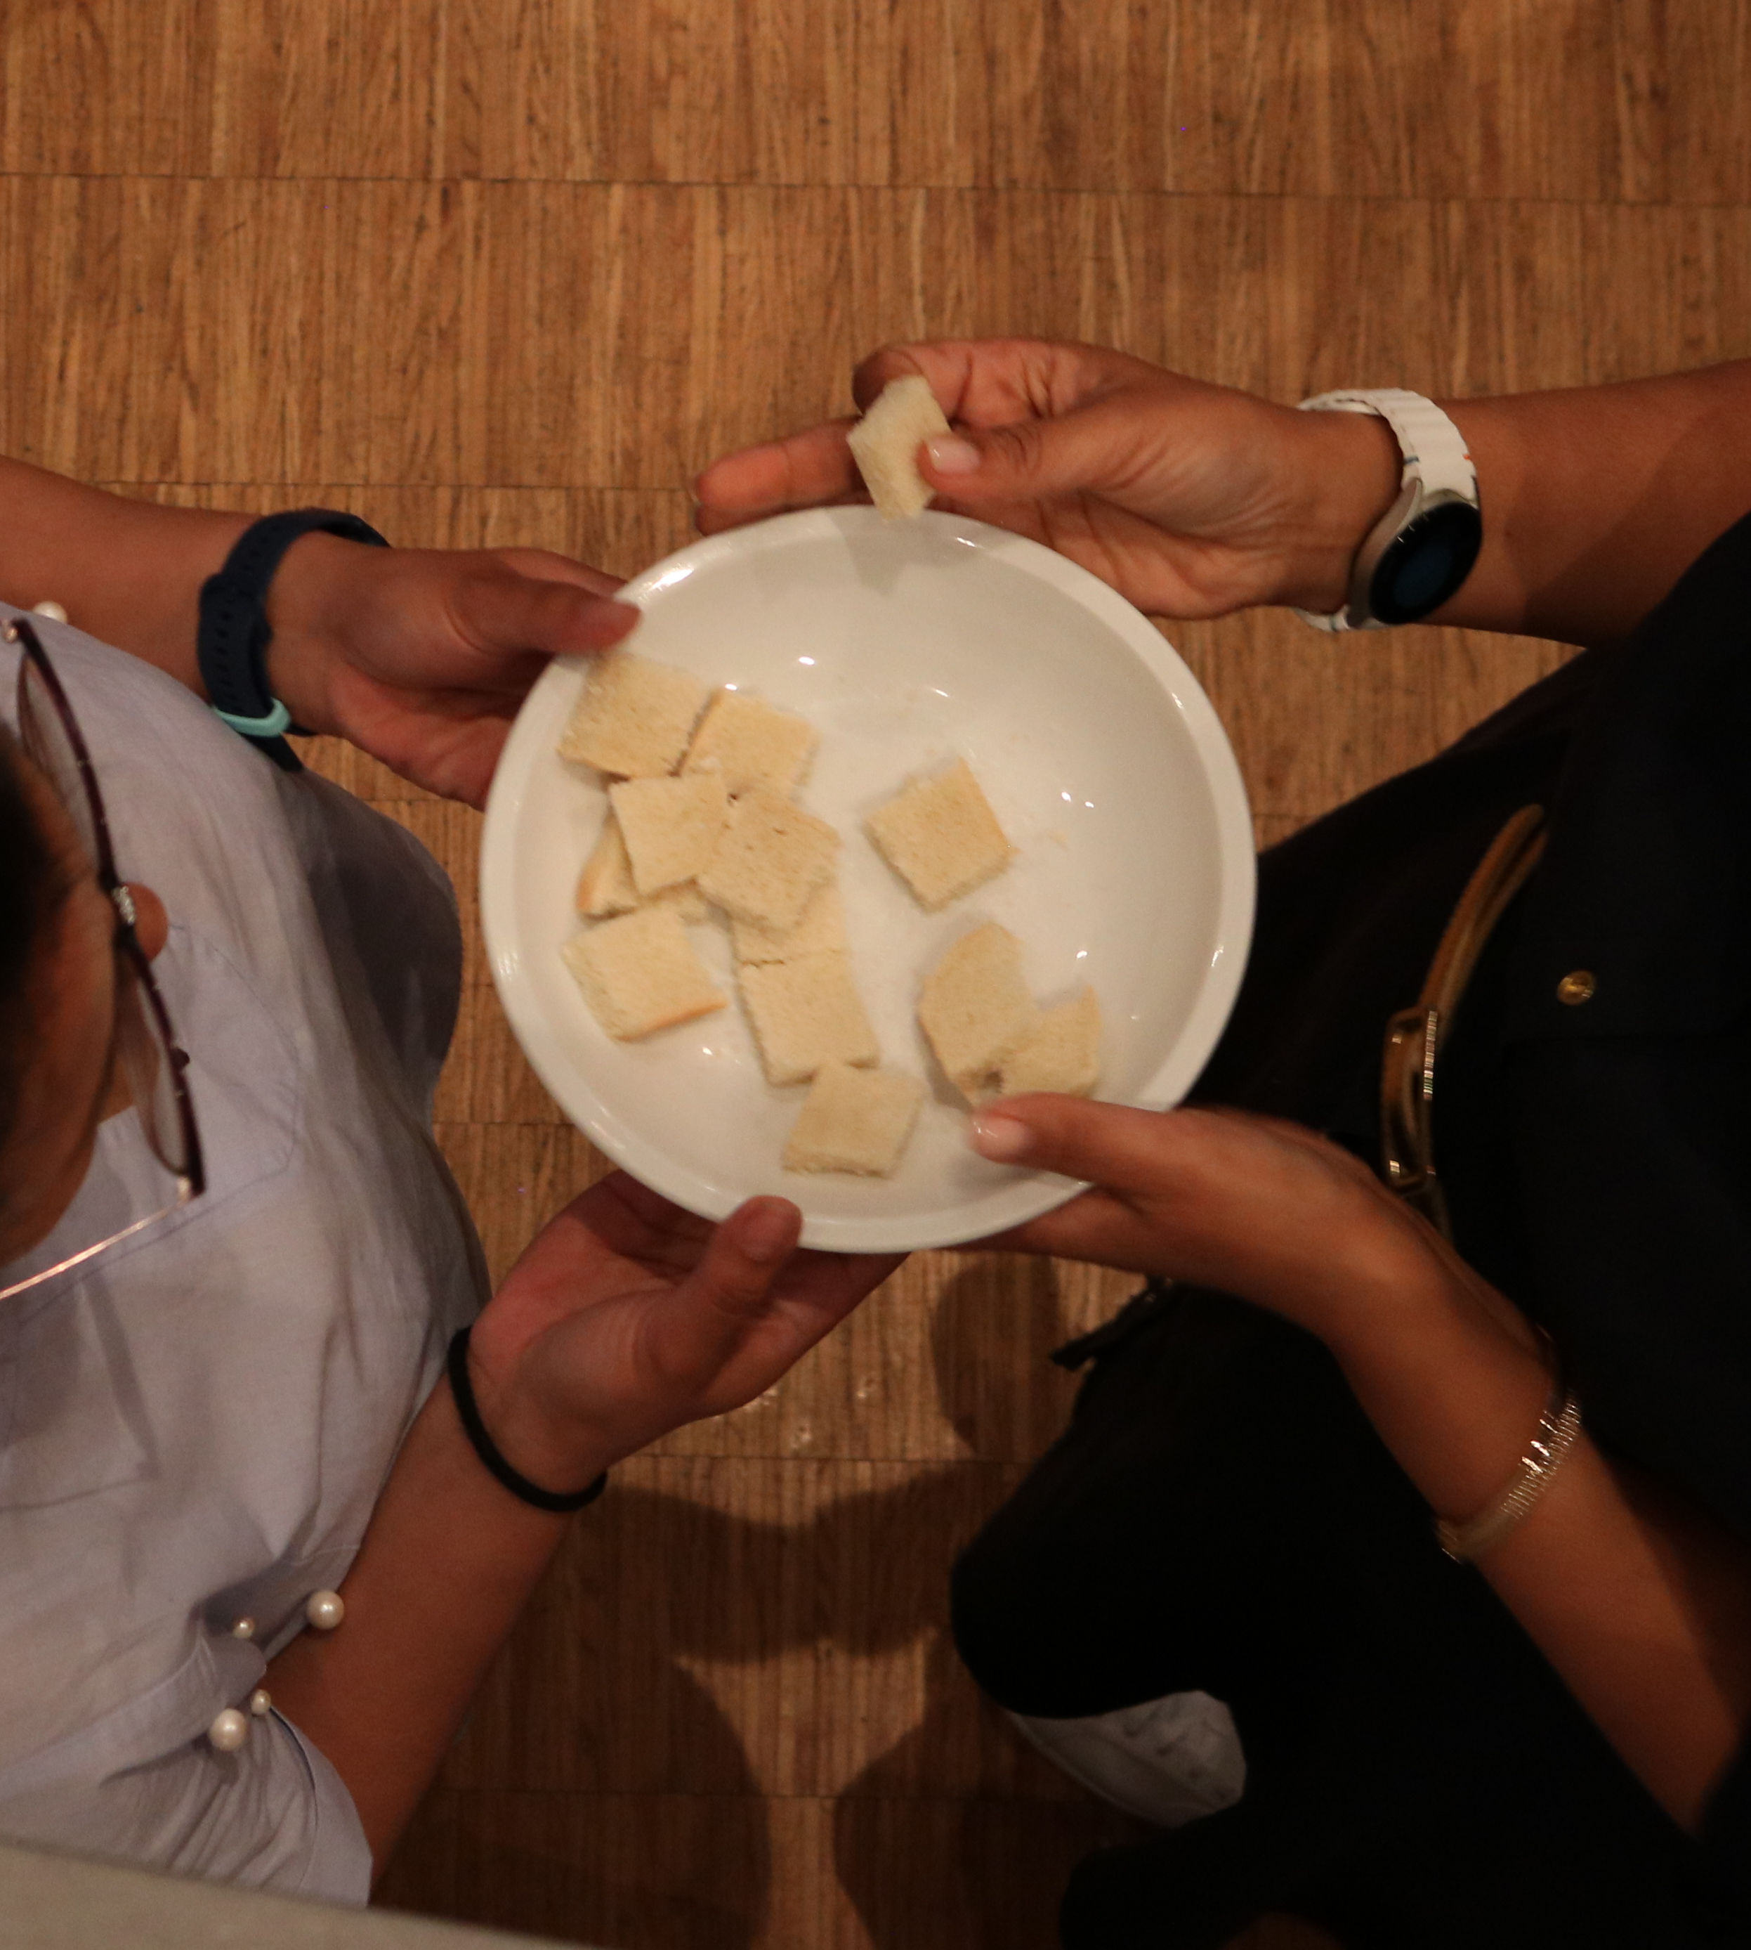
1
God is known to us as Father, Son and Holy Spirit, the Creator who seeks to restore fallen humanity by calling a people to be faithful in fellowship, worship, service and witness.

Slide 3
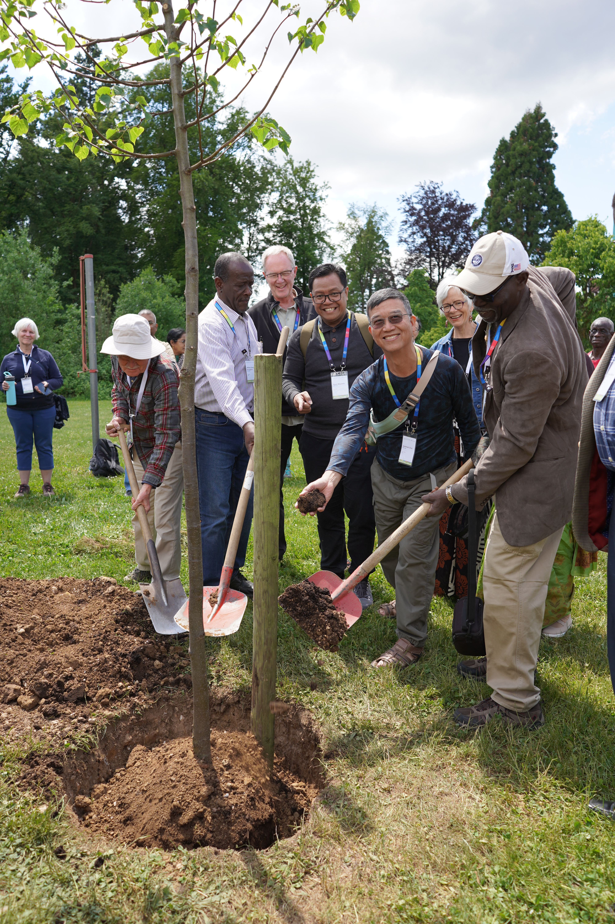
2
Jesus is the Son of God. Through his life and teachings, his cross and resurrection, he showed us how to be faithful disciples, redeemed the world and offers eternal life.

Slide 4
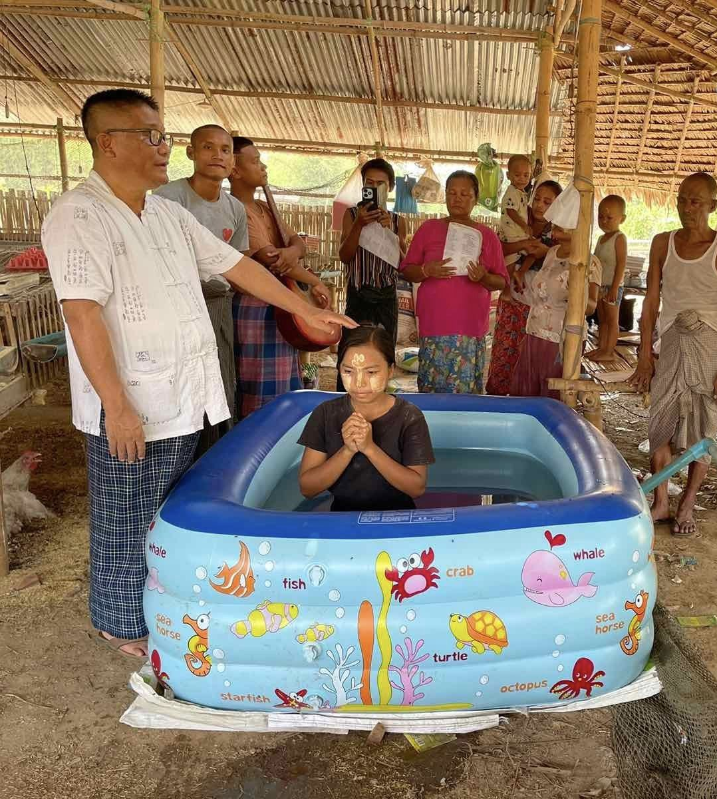
3
As a church, we are a community of those whom God’s Spirit calls to turn from sin, acknowledge Jesus Christ as Lord, receive baptism upon confession of faith, and follow Christ in life.

Slide 5
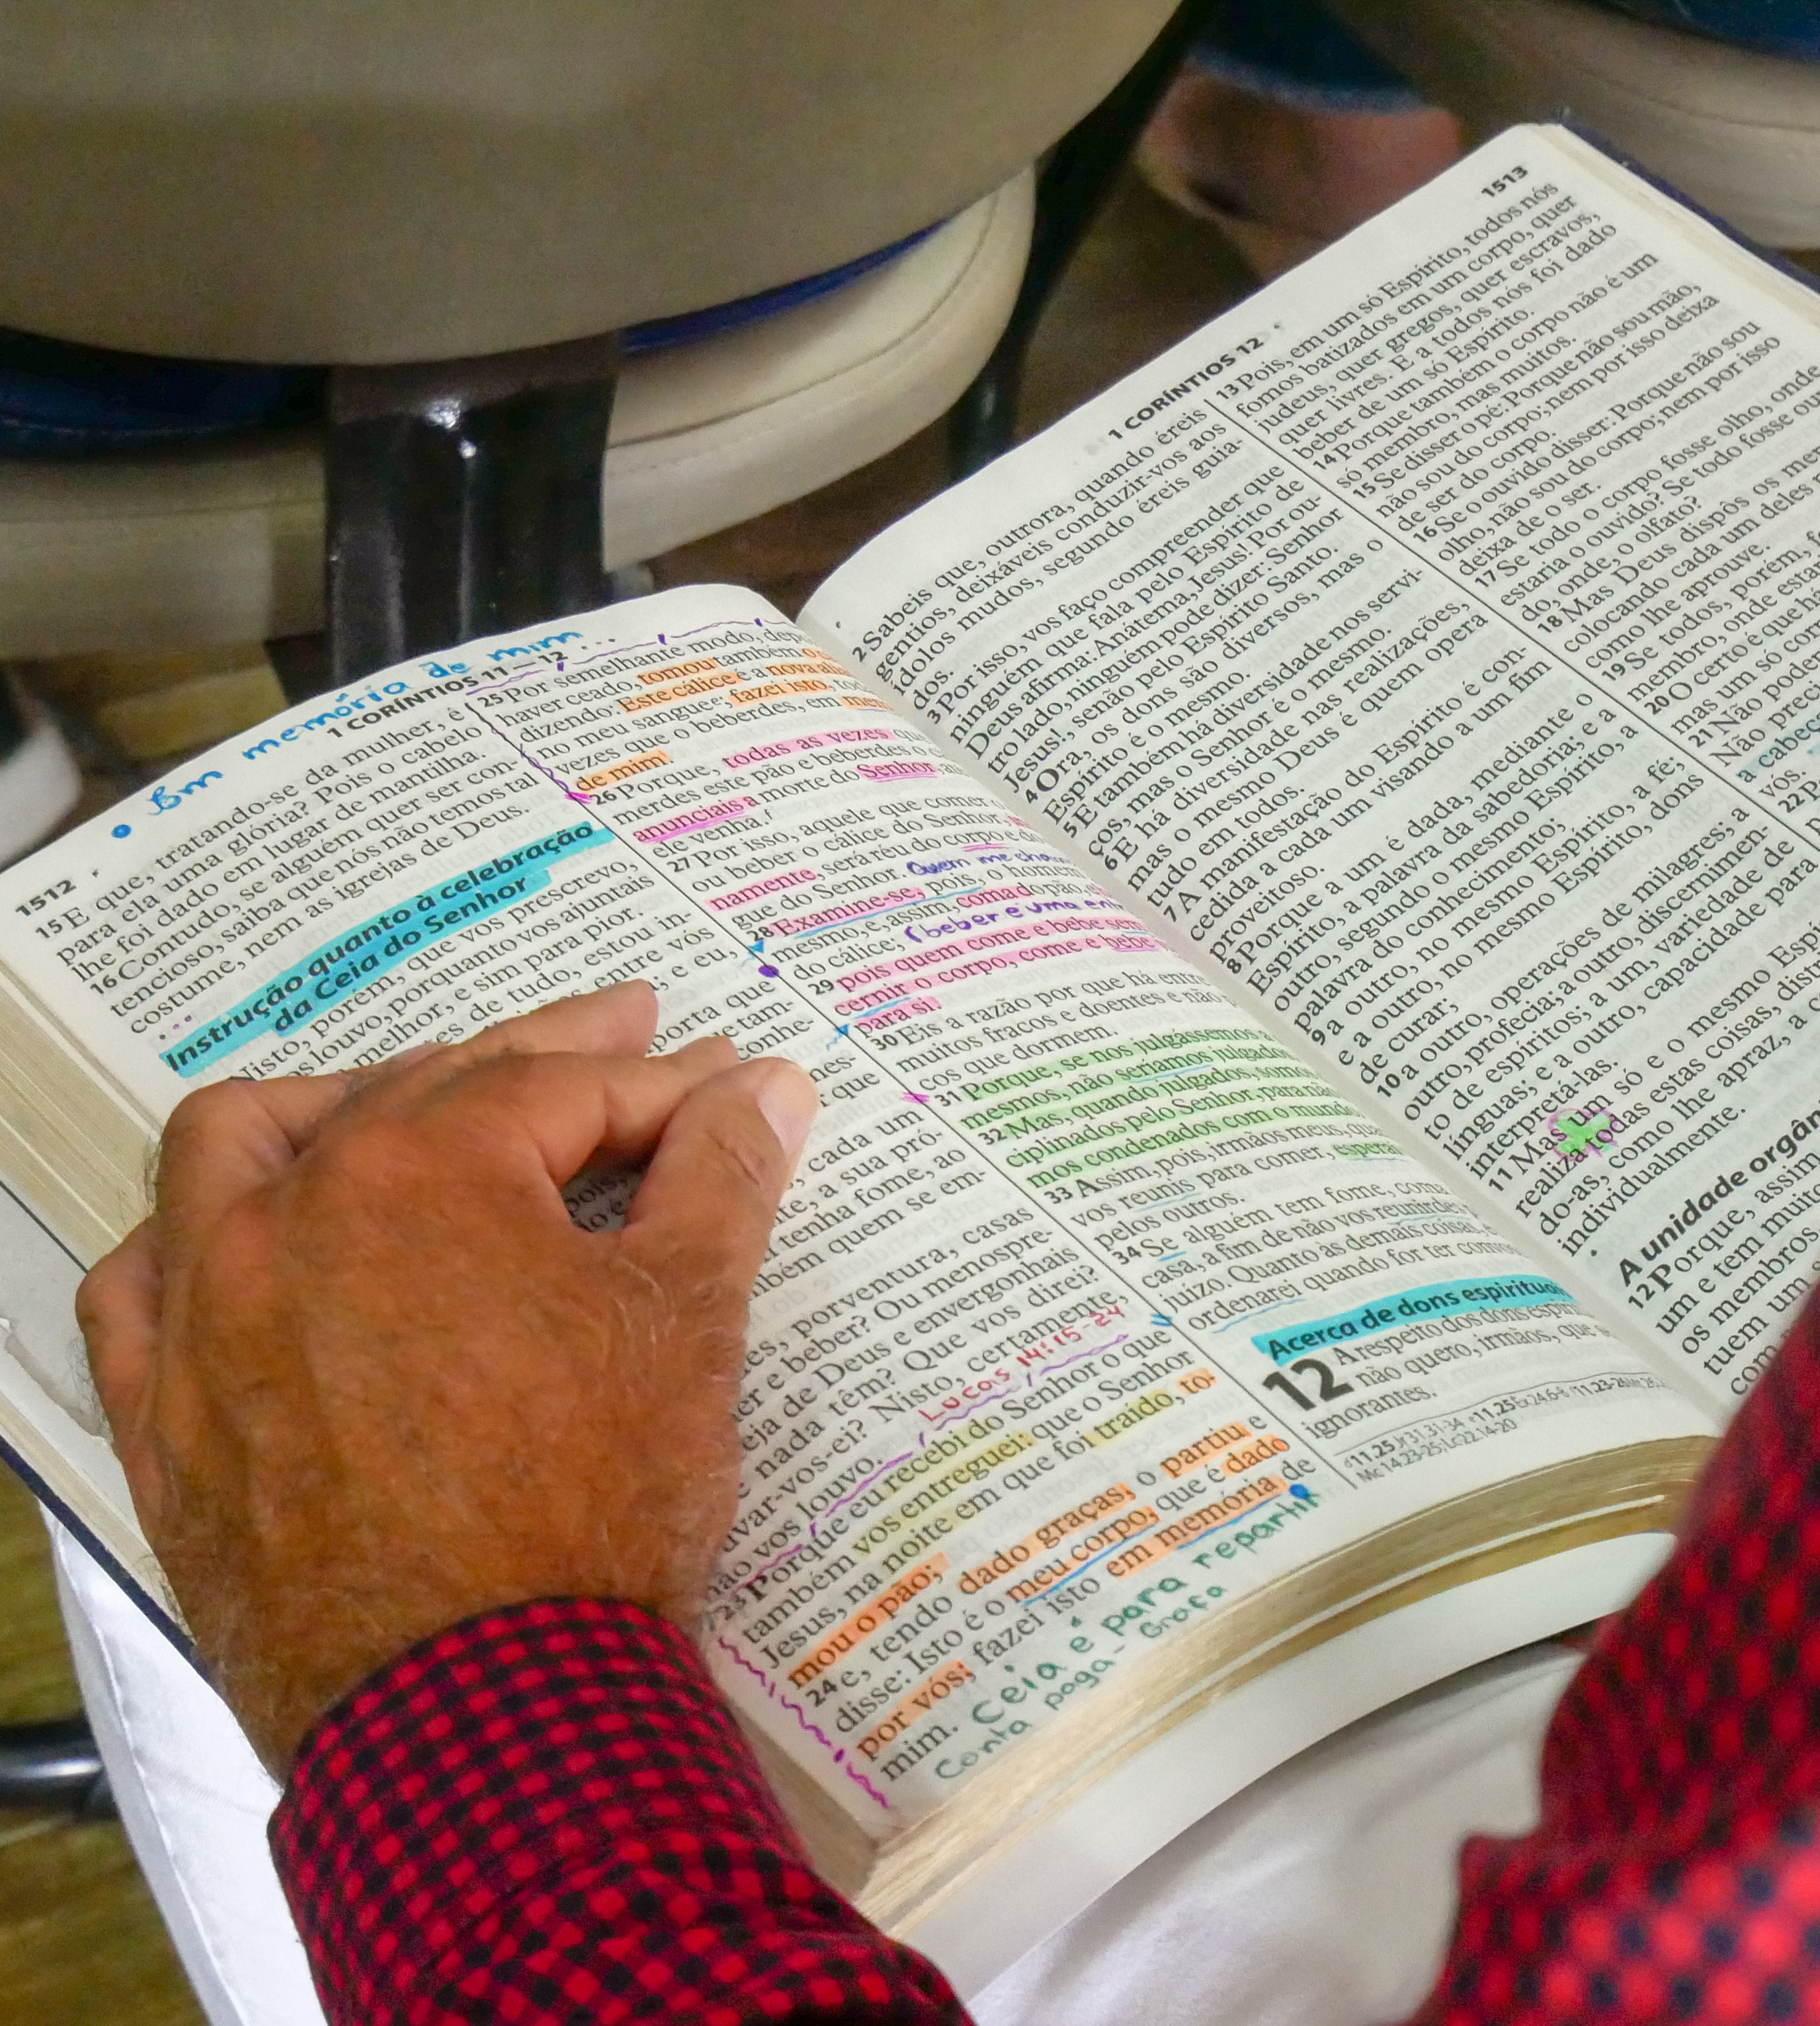
4
As a faith community, we accept the Bible as our authority for faith and life, interpreting it together under Holy Spirit guidance, in the light of Jesus Christ to discern God’s will for our obedience.

Slide 6
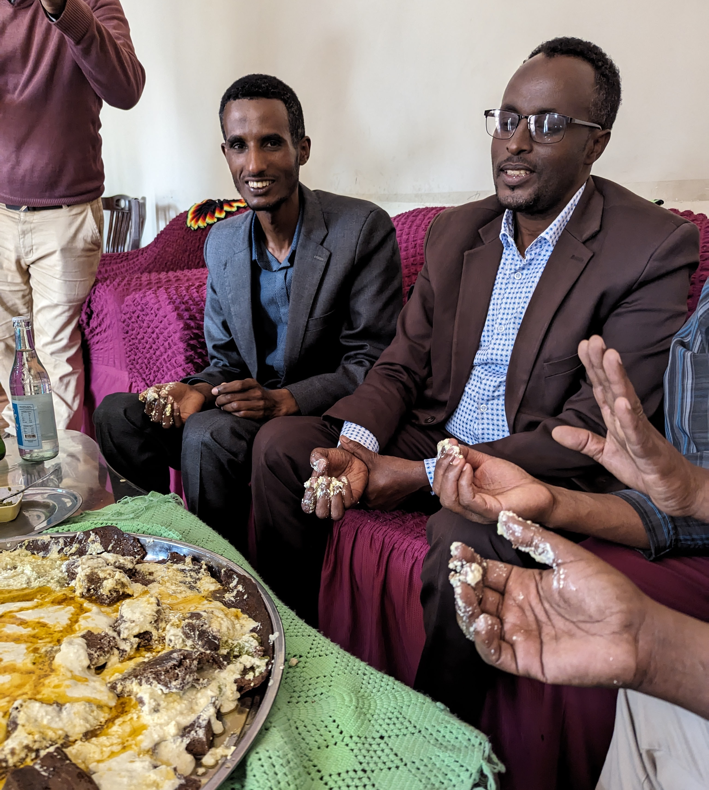
5
The Spirit of Jesus empowers us to trust God in all areas of life so we become peacemakers who renounce violence, love our enemies, seek justice and share our possessions with those in need.

Slide 7
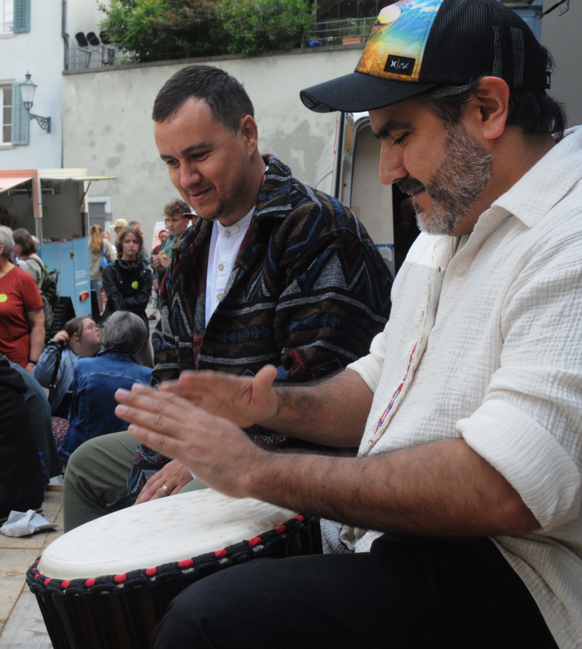
6
We gather regularly to worship, to celebrate the Lord’s Supper and to hear the Word of God in a spirit of mutual accountability.

Slide 8
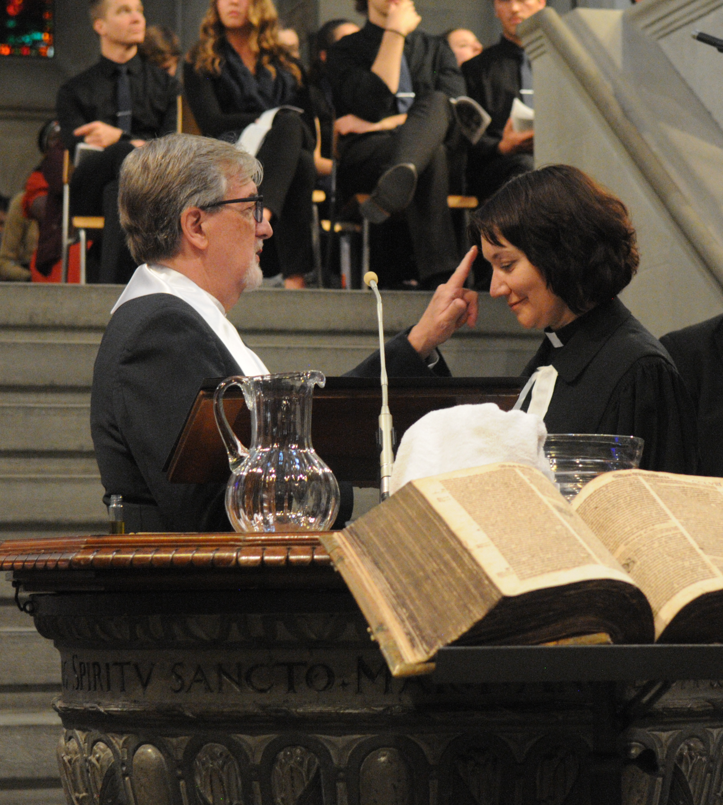
7
As a worldwide community of faith and life, we transcend boundaries of nationality, race, class, gender and language. We seek to live in the world without conforming to the powers of evil, witnessing to God’s grace by serving others, caring for creation and inviting all people to know Jesus Christ as Saviour and Lord.

